Slide 1

Hardware Enclave
Computer System Principles, Fall 2020 (IPADS, SJTU)
Live with bugs
Yubin Xia

Slide 2
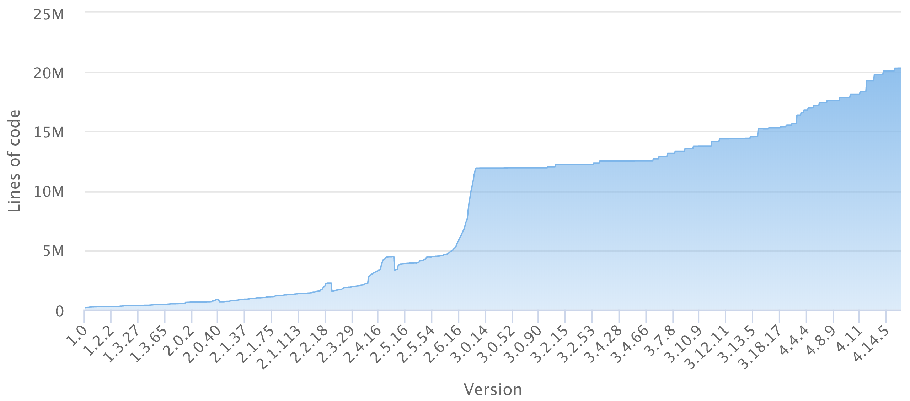
Background
OS/Hypervisor has too much code as TCB
Lines of code in different versions of Linux

Slide 3
Background
OS/Hypervisor has too much code as TCB
  More and more bugs are founded and make OS/hypervisor vulnerable
    CVE-2016-5195: user application can write read-only memory via the vulnerability in copy-on-write mechanism and thus get root privilege
    CVE-2018-16597: user application can modify underlying database he is not supposed to access via incorrect permission check logic in kernel
    Etc.
  Malicious application can compromise OS/hypervisor via its vulnerability to attack other application
    Things get worse in cloud environment where applications of multiple clients execute on the same machine

Slide 4
Background
Moreover, cloud vendors may not be trusted by very security-sensitive clients
  Security-sensitive clients want to use cloud vendors' computing resource
  Whereas they do not allow cloud vendor to get the plain text of their data(confidentiality)
  Neither do they allow cloud vendor to casually modify their data (integrity)

Slide 5
Background
Thus we have enclave
  Technology to provide secure execution environment (aka enclave)
  Only have a small TCB (hardware feature, CPU microcode, or small privileged software)
  Use TCB to provide confidentiality, integrity and freshness guarantees for application executing in enclave environment

Slide 6
Background
Attacks need to be considered
  Privileged software attack from compromised OS/hypervisor
  Side channel attacks applied by malicious application executing
  on the same machine
  Physical attacks applied by cloud vendor
    Memory bus snooping
    Cold boot attack / NVM
    Etc.

Slide 7
What is an Enclave?
Hardware-assisted Trusted Execution Environment (TEE)
Enclave
Trusted
Host App
Enclave App
Non-sensitive code/data
Sensitive code/data
User
OS
Supervisor
Hypervisor
Hypervisor
TEE/Enclave extension
Hardware

Slide 8
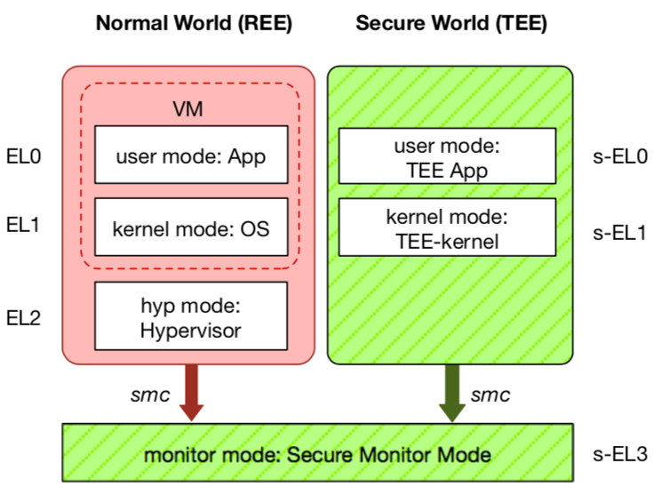
TEE: Trusted Execution Environment
Widely deployed on mobile devices
  Every Android device must deploy TEE
  Mostly based on ARM TrustZone
An isolated & privileged environment
  TEE can access all DRAM & peripherals
  REE cannot access TEE's resources
Designed to be secured and small
  For security-critical tasks (e.g., fingerprint
  checker, mobile payment, etc.)
Notes:
Before presenting virtualization of TEE, let me introduce TEE a little bit.
TEE is short for xxx. It has been widely deployed on mobile devices. Thanks to Google, now every Android phone needs to have TEE to pass Google's test.
On mobile phone, most TEE are based on ARM TrustZone.
TrustZone divides one system to two worlds: xxx and xxx.
The normal world, aka REE, runs rich OS like Android or iOS. It has three layers: one for hypervisor, one for kernel and one for application.
The secure world, aka TEE, has three layers: one for TEE OS and one for TEE applications.
There is a special layer, called monitor mode or s-EL3, is used for switching between the two worlds. It is also part of the secure world but share the same privilege with s-EL1.
The switching is done through smc instruction.
The green part is TEE, which is an isolated environment with higher privileged than the REE.
It means that xxx
The TEE is designed to xxx, its typical usage is xxx.

Slide 9
A Brief History of TEE
Stage-1 (before 2012): A fixed piece of code by venders
  Used for secure boot and firmware lock
Stage-2 (2012 ~ 2017): Some pre-installed trusted apps (TAs) by venders
  New applications: Biometric authentication (fingerprint, iris, 3D face, etc.),
  mobile payment, Digital Rights Management (DRM), etc.
  New functionalities: Runtime protection (e.g., Samsung KNOX)
Stage-3 (2017 ~ now): Support dynamic installation of third party TAs
  A trend for openness and flexibility
  Various TEEs and trusted apps are being deployed
Notes:
TEE is evolving. I divide its not-long history to three stages.
Before 2012, most TEE runs only a small fixed piece of code by phone venders. The major functionality is for secure boot and firmware lock.
After that, TEE becomes more complex and has more applications, like xxx and xxx. Some phone venders also use it for defending against jailbreak and rooting, like Samsung's KNOX.
Now, more and more TEEs support dynamic installation of third party TAs, which shows the trend of xxx.

Slide 10
Current Eco-system of TEE
Fragmentation of TEE
  From chip venders: QualComm, Spectrum, etc.
  From phone venders: Apple, Huawei, etc.
  TEE OS venders: TrustKernel, Trustonic, Google, Linaro, etc.
  Many other implementations based on OP-TEE
Trusted applications:
  1. must be ported to each TEE OS, and,
  2. have to trust the underlying TEE OS
Notes:
However, the openness also leads to fragmentation.
Nowadays, there are many different kinds of TEE OS, from different venders.
Also, many other implementations based on OP-TEE.
This is not a good news for trusted app developers, since they need to port and trust.

Slide 11
VM-based Enclaves

Slide 12
Review: Extended Page Table (EPT)
Translate guest physical addr to host physical addr
  The two-level translation are all done by hardware
EPT is manipulated and maintained by hypervisor
  Hypervisor controls how guest accesses physical address
  Any EPT violation triggers VMExit to hypervisor
Guest Virtual Address (GVA)
Guest
Page table
Guest Physical Address (GPA)
EPT
Host Physical Address (HPA)

Slide 13
Memory Isolation using EPT Mechanism
Leverage EPT mechanism to shadow secret memory
  Data segment: secret memory is removed from main EPT
  Code segment: sensitive functions only exist in secret EPT
Main EPT
Secret EPT
Other Data
Data Segment
Secrets
Other
Logics
Code Segment
Sensitive Functions
Springboard
Trampoline

Slide 14



HeartBleed Attack
In-application memory disclosure attack
  One over-read bug discloses the whole memory data
Affect over 60% of websites
  Attackers can steal private keys and user accounts
010000100001110100001001001001010privatekeys101100111100010password001011110010000111110
Heartbeat msg
Memory
Attackers
Arbitrary memory data
Over-read bug

Slide 15
ARM TrustZone

Slide 16
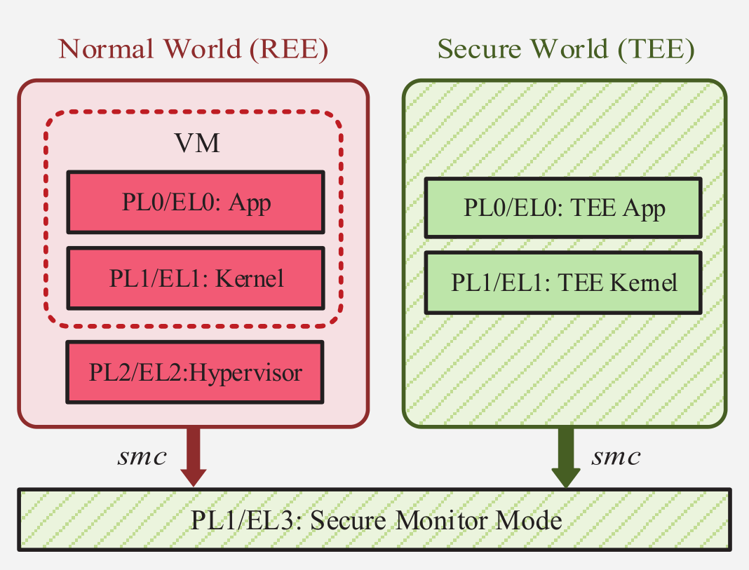
TrustZone and TEE
Two execution environments
  REE: Normal world
  TEE: Secure world
REE (Rich Execution Environment)
  Run rich OS and apps, e.g., Android
TEE (Trusted Execution Environment)
  Run small OS and apps
  Has higher privilege

Slide 17
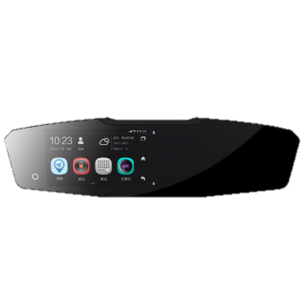
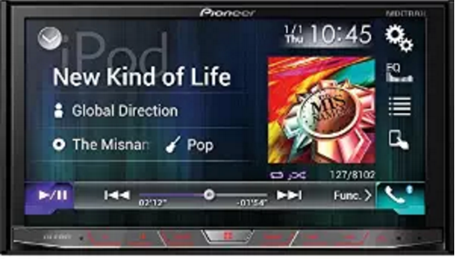

TEE on In-Vehicle Infotainment
Secure Authentication
  Start through fingerprint
  Secure payment for digital content, oil, etc.
Secure Connection
  Internet: Through SoftSIM to switch between carriers
  Connection with smartphone for unlocking and remote controlling
Isolation with Entertainment
  Use TEE for secure authentication and connection

Slide 18
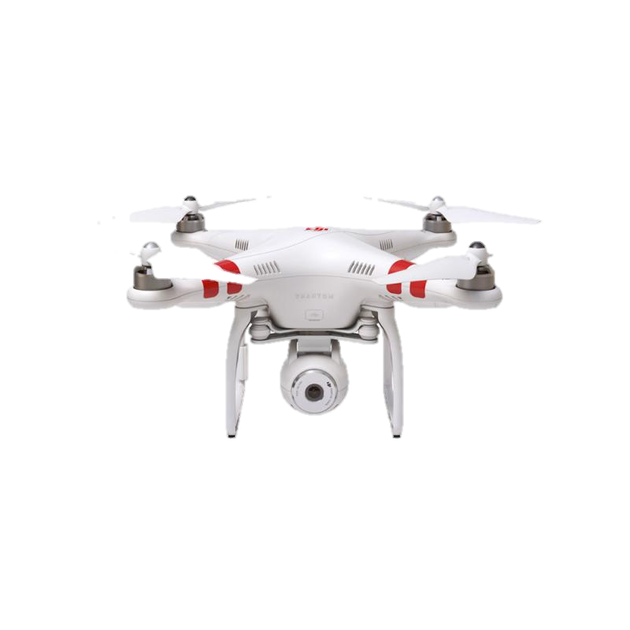
TEE in Drones
Secure Control Policies
  No-fly zone: using GPS to restrict fly zone through TEE
  Owner authentication: using biometrics on remote controller
  Other fly-policies: return to specific spot under certain conditions
Security Enforcement
  Enforce policies through secure boot/secure storage
  Tamper-resistant even under physical attacks

Slide 19
Security of Wearable Devices
Binghamton Univ.
  Yan Wang et al.
  Infer PIN code through hand movement
  Accuracy: 80%
  After 3 times tries: >90%
Security Suggestion
  Apply TEE on devices
  Use the other hand…
Wang, Chen, et al. "Friend or Foe?: Your Wearable Devices Reveal Your Personal PIN." AsiaCCS. ACM, 2016.

Slide 20
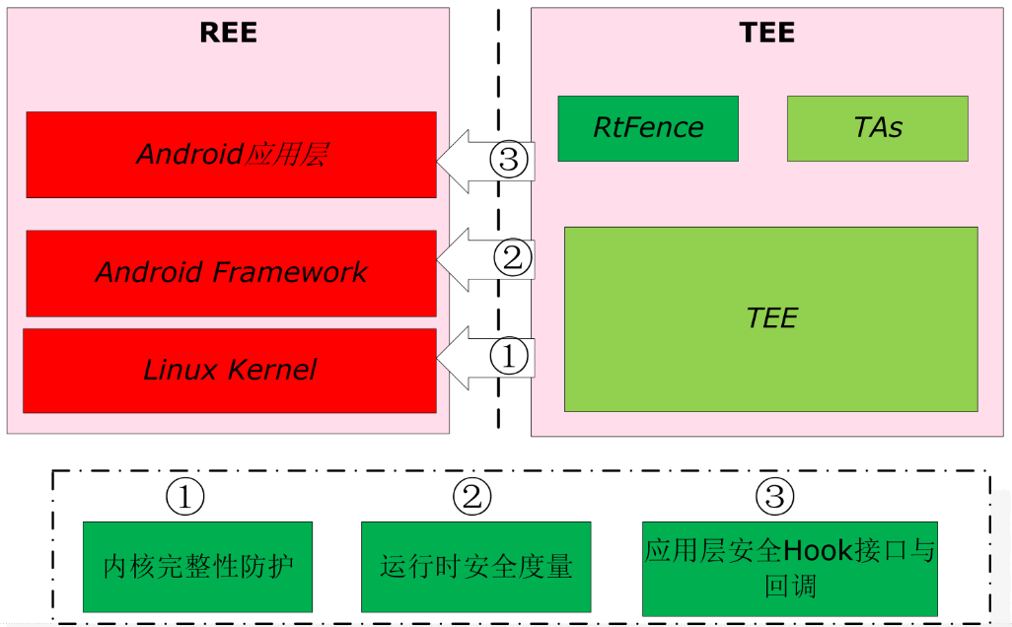
Real-time Kernel Protection on TEE
Kernel Integrity Monitoring
  Enforce the integrity of kernel's critical
  data and code
Runtime Measurement
  Protect the lifetime of critical data
Hook/callback of Secure Service
  Offer interface for up-level software

Slide 21









TEE & Hypervisor: More Flexible Architecture
High-bandwidth Tasks
  Current TEE is for low-bandwidth tasks
  Hard to be compatible with current system architecture
  E.g., secure iris, 4K video
Micro-Hypervisor Solution
  Lightweight way for security
  Meet the demand of most devices
Apps
Secure Apps
TAs
Android
AppVM
TEE
Trusted Hypervisor
Hardware

Slide 22
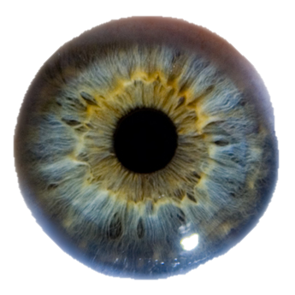
TEE-based Iris Protection Solution
Android
REE
TEE
APP
Iris TA
APP
APP
Iris Algo
Storage
Android
Iris AppVM
Iris Dev Controller
Linux
Kernel
Iris MIPI Driver
Secure Memory
Trusted OS
Iris I²C Driver
Micro-Hypervisor
Iris Scanning Device

Slide 23
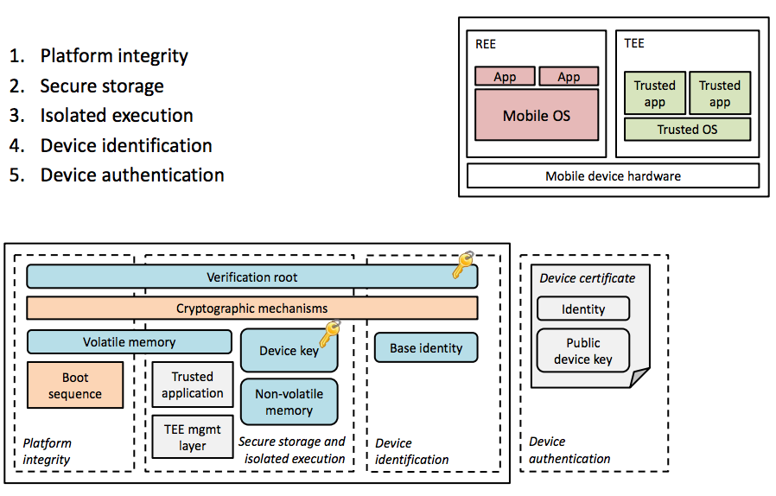
TEE Basic Usage

Slide 24
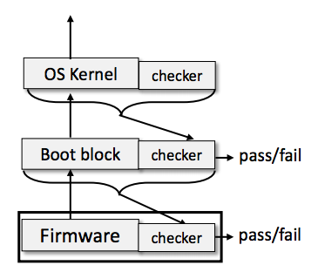
Secure Boot

Slide 25
SANCTUM ^{[USENIX Security'16]}

Slide 26
Overview
An enclave project for RISC-V processors
  Software hardware co-design
Provide isolation and defense of software attack even with malicious OS/hypervisor present
Provide defense of cache side channel attack
Small TCB
  Secure monitor: small software executing on machine mode
  RISC-V processor

Slide 27
RISC Overview
An open-source enclave project for RISC-V processors
  RISC-V: an open-source instruction set architecture
  Provides four privileges: user, supervisor, hypervisor and machine
User application
User application
User application
…
User
OS
Supervisor
Privilege goes up
Hypervisor
Hypervisor
Secure monitor
Machine

Slide 28
Threat Model
Compromised OS can be directly used to attack user applications' code and data
Applications executing on the same machine may infer victim's data access pattern via cache side channel
Sanctum assumes no physical attacks

Slide 29
Basic Architecture
Host App
Enclave App
Non-sensitive code/data
Sensitive code/data
User
OS
Enclave management
Supervisor
Hypervisor
Hypervisor(Unused)
Enclave multiplexing
Secure monitor
Machine
Hardware property:
Memory Region Isolation
Trusted
Untrusted

Slide 30
Software Architecture
Enclave apps:
Sensitive code & data
Isolated from other software
Host App
Enclave App
Non-sensitive code/data
Sensitive code/data
User
OS:
Wrap security monitor calls
OS
Enclave management
Supervisor
Hypervisor:
Multiplex the CPU cores
Hypervisor
Enclave multiplexing
Hypervisor(Unused)
Security monitor:
Ensure memory isolation
Enclave context switch & exception handling
Secure monitor
Machine

Slide 31
Hardware Property: Memory Region
Physical address
Tag
Cache set id
Cache line offset
Tag
DRAM region id
Page offset
DRAM
DRAM region1
DRAM region2
DRAM region3
DRAM region4
DRAM region1
DRAM region2
DRAM region3
DRAM region4
…
Enclave a
Enclave b
Use subset of cache set bits as DRAM region id
Security monitor manages DRAM regions
Security monitor ensures once a region is allocated to a enclave, this region can not be allocated to any other software

Slide 32
Hardware Property: Memory Region
Physical address
Tag
Cache set id
Cache line offset
Tag
DRAM region id
Page offset
DRAM
DRAM region1
DRAM region2
DRAM region3
DRAM region4
DRAM region1
DRAM region2
DRAM region3
DRAM region4
…
Enclave a
Enclave b
CPU record allowable memory region IDs of the executing process in a special register and checks it during memory accessing
Memory isolation
Enclave share no memory region with any other software, no share of cache set, thus no cache side channel
No cache side channel

Slide 33
Hardware Property: Memory Region
Physical address
Tag
Cache set id
Cache line offset
Tag
DRAM region id
Page offset
DRAM
DRAM region1
DRAM region2
DRAM region3
DRAM region4
DRAM region1
DRAM region2
DRAM region3
DRAM region4
…
Enclave a
Enclave b
The number of enclaves Sanctum supports simultaneously is limited
  The number of enclaves is limited by the number of memory regions
  The number of memory regions depends on number of cache set id's bits

Slide 34
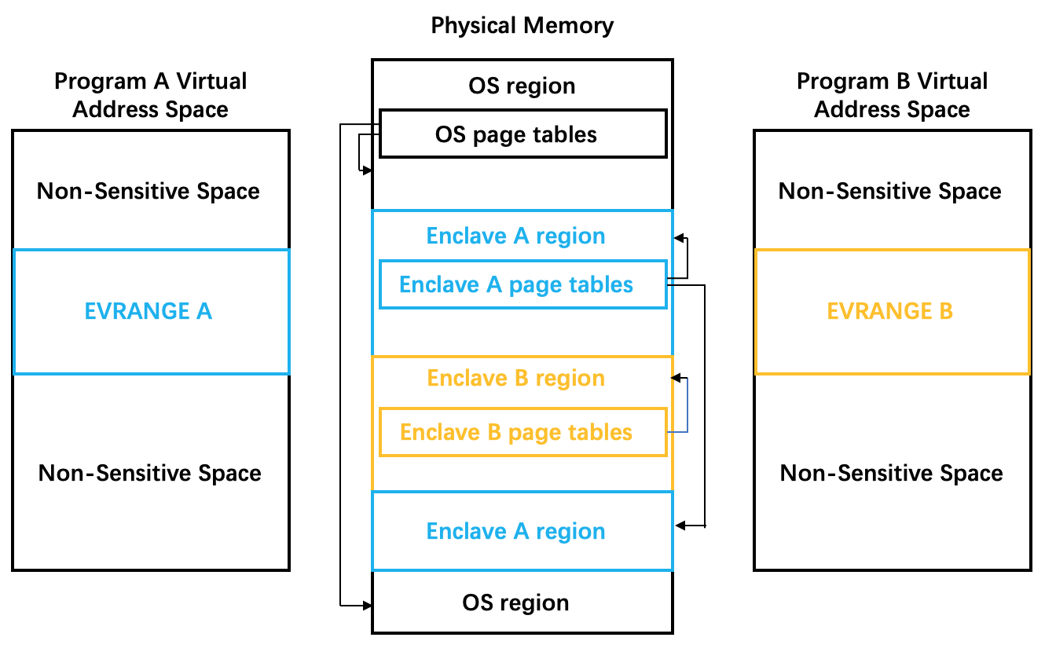
Hardware Property: Dual page table
Balance between isolation & communication
Two kinds of page table: enclave page table & host page table
Security monitor creates enclave page table and ensure it only map to region of current enclave
CPU uses enclave page table when access virtual memory in EVRANGE

Slide 35
Conclusion
Isolation between enclave and software out of enclave
  Security monitor ensures no memory region overlap during enclave creation
  CPU records allowable region ids of current thread and checks it during memory accessing
Isolation between enclave and each other
  Security monitor ensures no memory region overlap during enclave creation
  CPU records allowable region ids of current thread and checks it during memory accessing
Defense against cache side channel attack
  Memory region partition

Slide 36
Limitation
Vulnerable to physical attacks
  Bus snooping, cold boot attack, etc.
Not support dynamically allocating new memory for enclave
  Enclave's memory region can only be set during enclave creation
  This is limited by its memory region's design
Limited number of enclaves supported simultaneously
Notes:
Sanctum同样没有针对cache side channel以外的side channel进行专门的设计，但是却能防御大部分side channel，这是因为riscv处理器本身与X86处理器的区别，例如，riscv处理器本身没有超线程，没有乱序执行。

Slide 37
xom

Slide 38
History of Memory Encryption
AMD SME
Bastion
HyperCoffer
XOM
XOMOS
AEGIS
AISE-BMT
SecureME
Intel SGX
2000
2003
2007
2010
2011
2013
2016
2017
Counter-mode encryption
Merkle-tree based integrity check

Slide 39
eXecute-Only Memory (XOM)
Architectural Support for Copy and Tamper Resistant Software
  David Lie, Chandramohan Thekkath, Mark Mitchell, Patrick Lincoln, et al. from Stanford university
ASPLOS 2000

Slide 40
eXecute-Only Memory (XOM)
Threat model
  Do not trust OS and external memory
Propose execute-only code
  Provides copy protection and tamper-resistance functions
  Code and data are encrypted in memory
  Store hash of encrypted value and its virtual address
Abstract XOM machine
  Compartment for each applications
  Decode the compartment key using an asymmetric cipher
  Decode the compartment content using the compartment key
  Instruction for entering and exiting the compartment
  Data tagging scheme for prevents cross-compartment access

Slide 41
XOMOS
Implementing an Untrusted Operating System on Trusted Hardware
  David Lie, Chandramohan Thekkath, Mark Mitchell, Patrick Lincoln from University of Toronto, Microsoft research and Stanford university
SOSP 2003

Slide 42
XOMOS
XOM purpose: protect master secret key, and enforce compartment
Requirement on the interface between XOM and OS
  OS should make resource management efficient and effective
  OS cannot violate the isolation of a compartment
Modification required
  Modifications for XOM Key Table maintenance
  Modifications for dealing with encrypted data
    Paging Encrypted Pages
  Modifications for traditional operating system mechanisms
    Shared libraries: alter compiler to caller-save calling convention
    Process creation: different key management
    User defined signal handlers

Slide 43
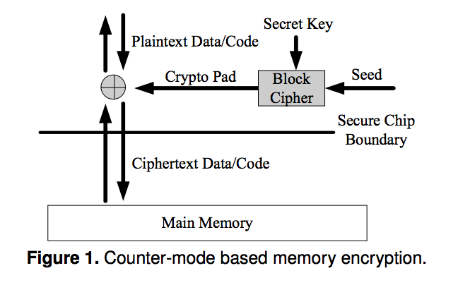
Counter-Mode Encryption
Security: Pad is unique
Approaches:
global counter
block address

Slide 44
Counter-Mode Encryption Problems
Seed with global counter
  Counter reuse
  Large on-chip counter cache storage
Seed with block address
  Physical address may change due to page swap
  Virtual address is vulnerable to pad reuse

Slide 45
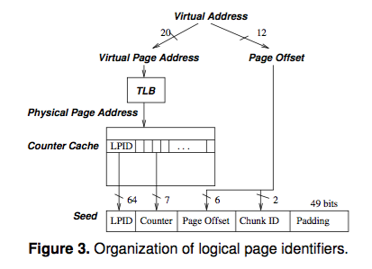
Address Independent Seed Encryption
For each chunk in the memory, its seed is the concatenation of:
  a Logical Page IDentifier (LPID)
  the page offset of the chunk's block
  the block's counter value
  the chunk id.

Slide 46
Memory Integrity Verification
Replay attacks for simply computing MAC
Merkle tree verification
  Keeps hierarchical MACs organized as a tree
  The root of the tree is stored on-chip
  Verification by checking chain of MAC values up to the root MAC

Slide 47
Intel SGX

Slide 48
Why Intel SGX?
Motivation: untrusted privileged software
  E.g., protect application from untrusted OS
What if the OS direct accesses application's memory?
  Data are encrypted in memory
  Data can only be accessed by the app within CPU boundary
  The TCB contains only the CPU and app, no OS

Slide 49
How can Memory Always be Encrypted?
Question: data will eventually be decrypted when using
  Then, what if an attacker steal data when it is being used?
Solution: only decrypt data inside CPU (in cache)
  The attacker now has to steal data directly from CPU

Slide 50
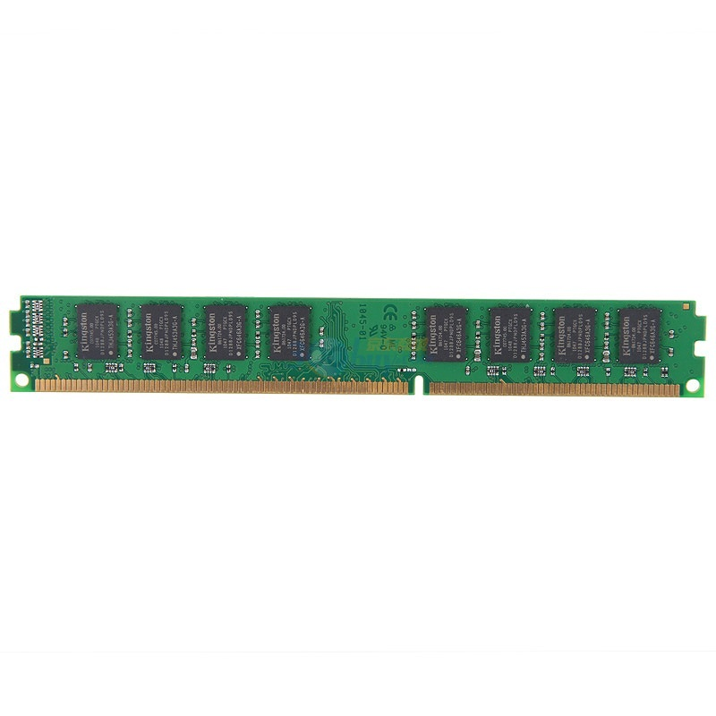
Counter-mode Encryption
Address
Data Cache
Counter Cache
Data (PlainText)
Counter
Encrypt
XOR
PAD
VM-Key
Secure Processor
Data (CypherText)
Counters

Slide 51
Merkel Tree for Data Integrity
Secure Processor
Root
Data (CypherText)
Counters
Hash

Slide 52
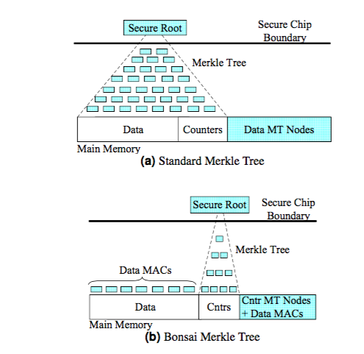
Bonsai Merkle Trees
Each block is protected by its own MAC, computed using a keyed hashing function (e.g. HMAC based on SHA-1),
The block's MAC includes the counter value and address of the block, and
The integrity of all counter values is guaranteed.

Slide 53
Merkle Tree(26.7%)
Proccesor
Root
Memory
……
MAC1
MAC2
……
MAC8
8B
64B
MAC1
MAC2
……
MAC8
……
MAC1
MAC2
……
MAC8
MAC
MAC
Data Block
Data Block
……
Data Block
Data Block
count1
……
count2
64B
……

Slide 54
Bonsai Merkle Tree(14.9%)
Proccesor
Root
MAC = Hash(Data, Key, Counter)
……
Memory
Overhead:0.8%
MAC1
MAC2
……
MAC8
MAC1
MAC2
……
MAC8
……
MAC1
MAC2
……
MAC8
7b
7b
……
64b
7b
7b
……
7b
7b
……
64b
7b
7b
HASH
64b + 64 * 7b = 512b
Data Block
MAC1
Overhead:1.6%
MAC2
……
Overhead:12.5%

Slide 55
SGX Integrity Tree(26.6%)
Proccesor
Root
HASH
MAC
56b
……
HASH
56b
56b
56b
…………
Overhead:1.6%
56b
……
HASH
56b
56b
56b
HASH
HASH
MAC
56b
……
HASH
……
56b
56b
56b
……
56b
56b
56b
56b
HASH
Arity=8
HASH
8 * 56b = 448b
64b
Data Block
MAC1
Overhead:12.5%
MAC2
……
Overhead:12.5%

Slide 56
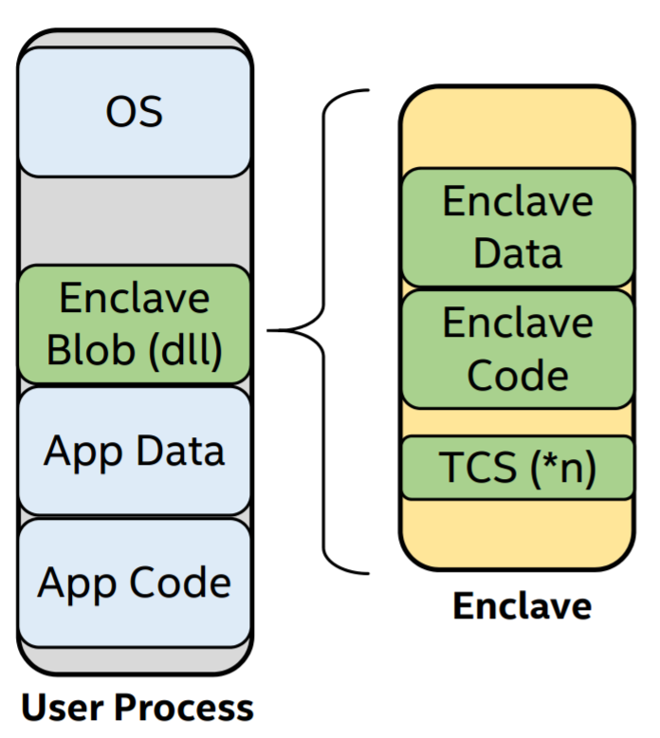
Process View
With its own code and data
Providing Confidentiality & Integrity
Controlled entry points
Multi-thread support
Full access to app memory and processor performance
Protected execution environment embedded in a process

Slide 57
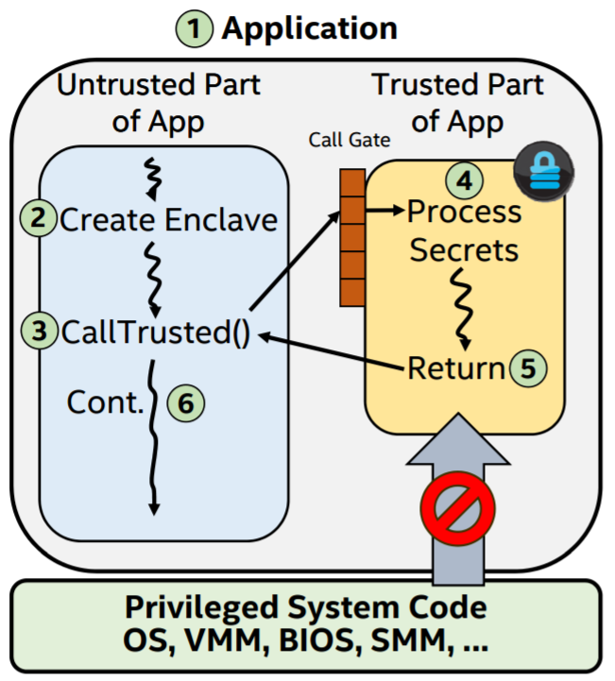
SGX Execution Flow
App built with trusted and untrusted parts
App runs & creates the enclave which is placed in trusted memory
Trusted function is called, execution transitioned to the enclave
Enclave sees all process data in clear; external access to enclave data is denied
Trusted function returns; enclave data remains in trusted memory
Application continues normal execution

Slide 58
Software Architectures of SGX
LibOS
Container
Application
Code Snippet
APP
APP
APP
APP trusted part
LibC interface
APP untrusted part
LibOS
LibC
Libc
Libc
OS
OS
OS
Virtual Machine
Virtual Machine
Virtual Machine
Virtual Machine
Hypervisor
Hypervisor
Hypervisor
Hypervisor
 | Compatibility | TCB Size | Ocall Num | Attack Surface | Protect OS
LibOS | Part | Large | Few | Small | ✔
Container | ✔ | Mid | Mid | Mid | ✘
Application | ✔ | Mid | Many | Large | ✘
Code Snippet | ✘ | Small | Few | Small | ✘

Slide 59
AMD's SME/SEV
SME: Secure Memory Encryption / SEV: Secure Encrypted Virtualization

Slide 60
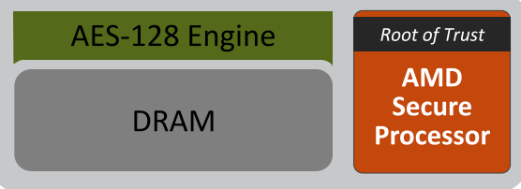
2016: AMD x86 Memory Encryption Technologies
Two Technologies
  AMD Secure Memory Encryption (SME) & AMD Secure Encrypted Virtualization (SEV)
Features
  Hardware AES engine located in the memory controller performs inline encryption and decryption of DRAM
  Minimal performance impact: Extra latency only taken for encrypted pages
  No application changes required
  Encryption keys are managed by the AMD Secure Processor
  and are hardware isolated
    Not known to any software on the CPU

Slide 61
Comparing with Intel SGX
The SME approach is different
  It will not protect memory from an attacker who has compromised the kernel
  It is intended to protect against cold-boot attacks, snooping on the memory bus, and the disclosure of transient data stored in persistent-memory arrays
SEV focuses on virtualization
  it can protect virtual machines from each other
  keeping their contents secure even if one of them manages to compromise the host system
  It should be able to protect virtual machines from the hypervisor itself

Slide 62
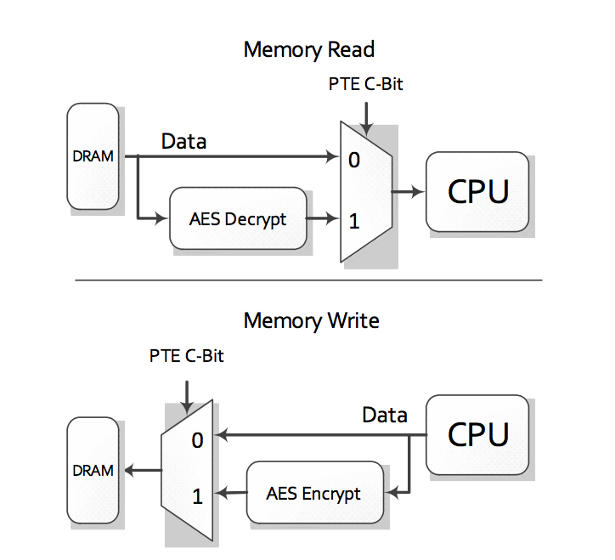
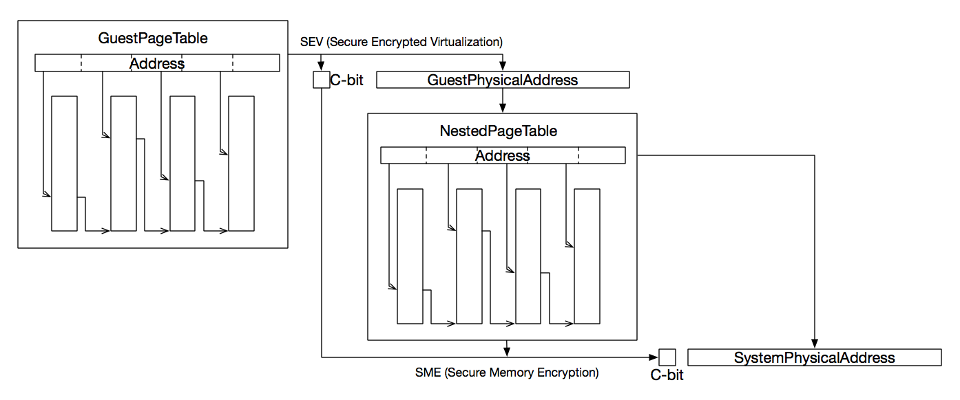
Usage of SEV

Slide 63
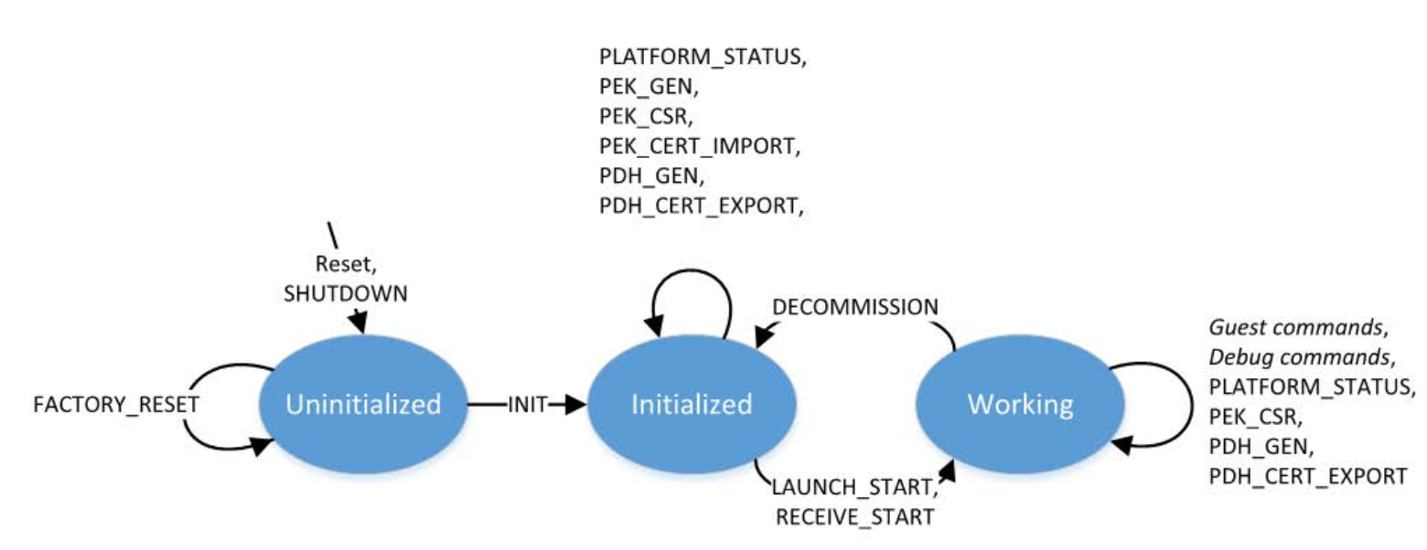
Lifecycle of Firmware

Slide 64
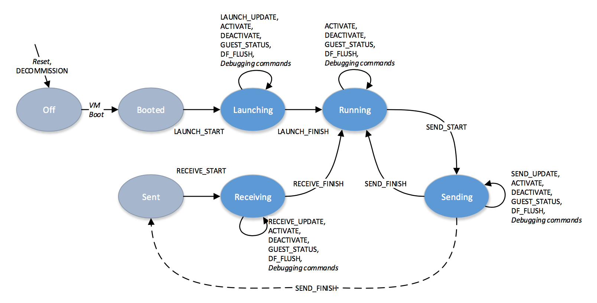
Lifecycle of Guest

Slide 65
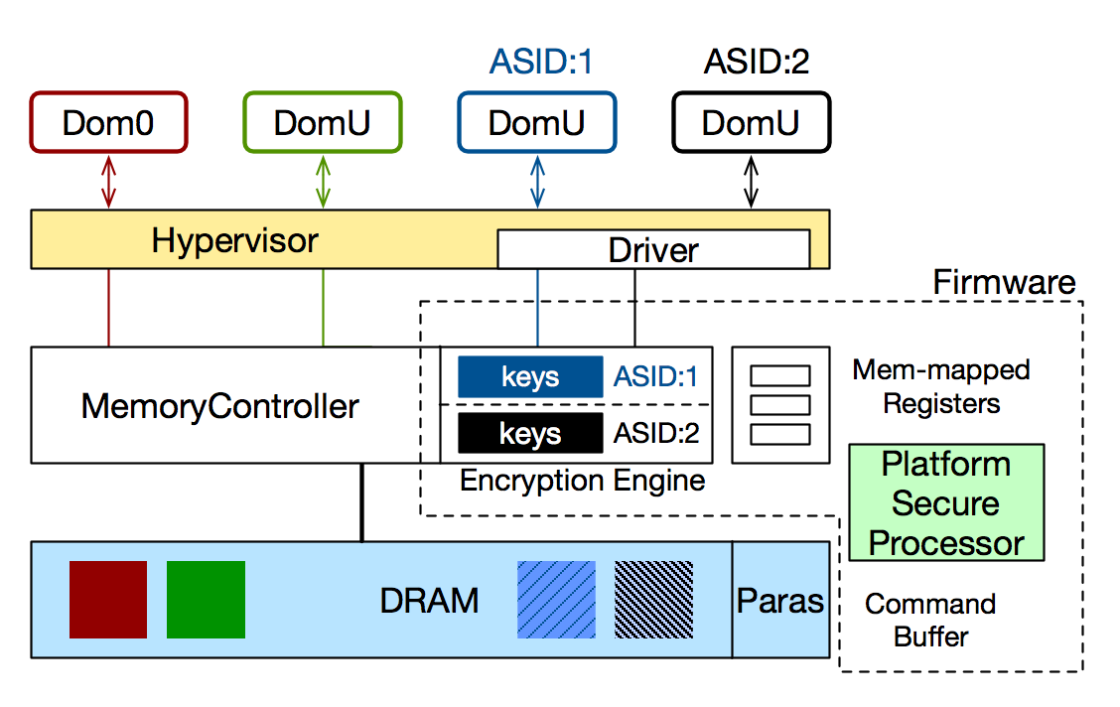
Architecture-Protect VM
Assume hypervisor is benign (not malicious, but not trusted)

Slide 66
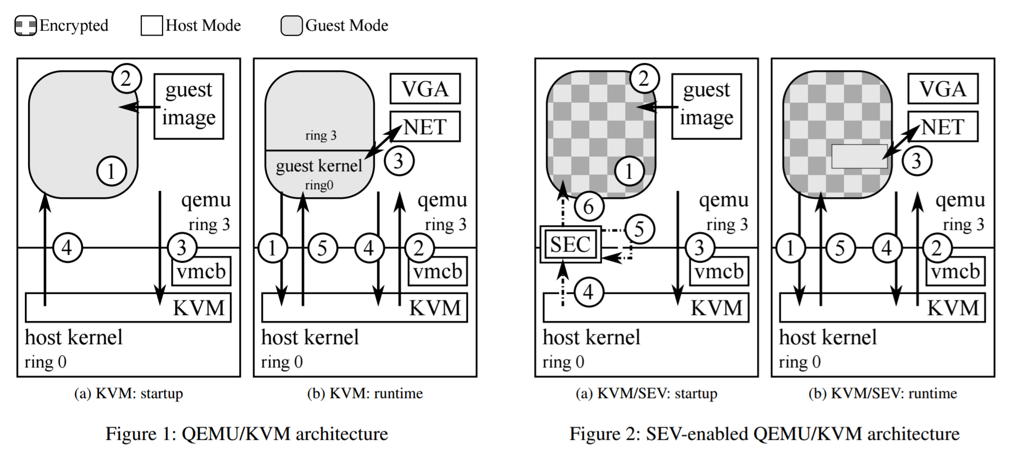
Runtime Behavior of SEV
Notes:
First, QEMU reserves memory for the VM (Figure 1a 1 ). Then it copies the guest binaries into this reserved memory (Figure 1a 2 ). By using the /dev/kvm device node the KVM module of the Linux kernel is instructed to start a new VM (Figure 1a 3 ). KVM then sets up a vmcb data structure incorporating the information from QEMU and issues the vmrun instruction to start the VM (Figure 1a 4 ). The processor now enters the guest mode, depicted in grey, and starts execution at the entry point defined in the vmcb.
The runtime behaviour is shown in Figure 1b. Upon any event that was configured in the vmcb to cause a vmexit, the CPU leaves guest mode and enters host mode again with a specific error code set in the vmcb (Figure 1b 1 ). The KVM module can then either handle the exit itself, or, in case of, e.g., an memory-mapped IO operation to an emulated device, can return to QEMU which then handles the request (Figure 1b 2 ). The emulated device can access guest memory directly to mimic DMA memory transfers (Figure 1b 3 ). After the request was served, QEMU calls KVM again (Figure 1b 4 ), which resumes execution of the VM in guest mode (Figure 1b 5 ).
Figure 2 shows how the classical KVM architecture looks like on an SEV-enabled system. Like detailed in the previous Section, QEMU communicates with the KVM module to prepare the VM for launch (Figure 2a 1 to 3 ). To enqemu ring 3 host kernel ring 0 guest image KVM vmcb 4 1 2 SEC 3 6 5 (a) KVM/SEV: startup qemu ring 3 host kernel ring 0 VGA KVM vmcb NET 1 5 3 4 2 (b) KVM/SEV: runtime Figure 2: SEV-enabled QEMU/KVM architecture able SEV for the newly allocated VM, it's memory must first be encrypted. The host kernel calls the coprocessor to do the initial encryption of the VM memory using a threefold command sequence, LAUNCH START, LAUNCH UPDATE and LAUNCH FINISH (Figure 2a 4 , 5 and 6 ).
Figure 2b shows the system configuration during runtime. The secure coprocessor (SEC) is not shown, as it is used mainly during VM startup. The steps composing the runtime behaviour under SEV (Figure 2b 1 , 2 , 4 and 5 ) do not differ from the non-SEV configuration. This is due to the fact, that cryptographic operations are handled transparently by the memory controller, while key management is handled by the secure processor without involvement of the hypervisor or the VM. However to facilitate DMA memory transfers (Figure 2b 3 ) similar to a classical setup, the guest is tasked to configure shared memory regions, that are exempt from encryption.

Slide 67
AMD SEV Security Considerations
The GP registers are not encrypted upon a VMExit
The VMCB is subject to manipulation by the hypervisor
There is no memory authentication scheme in use

Slide 68
TEE Security

Slide 69
More TEE Applications
TEE Malware Detection
REE Security Enhancement
More Applications
  FIDO、Trusted Mail, Trusted SMS, Trusted Call…

Slide 70

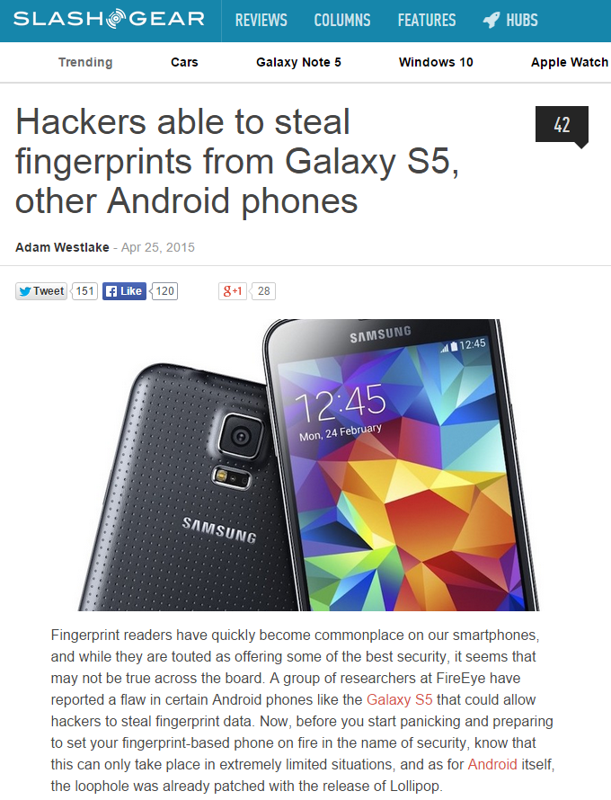
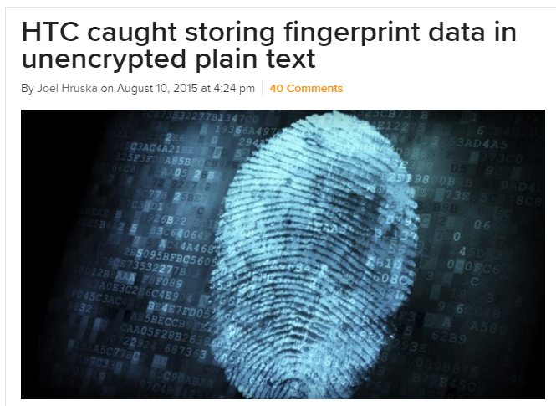

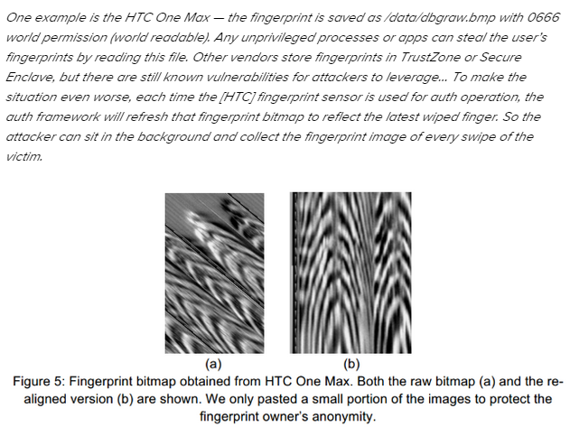
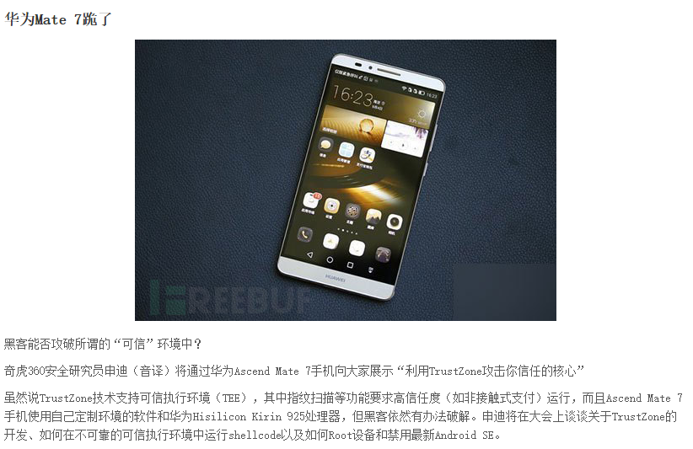
More and More TEE Vulnerabilities
http://www.extremetech.com/mobile/211985-htc-caught-storing-fingerprint-data-in-unencrypted-plain-text

Slide 71
TEE Attacking Surface
REE
TEE
①Secure boot
②TEE kernel
③TA security
④Hardware operation
⑤TEE/REE interaction
Application Java Layer
③
Trust Application Layer
CA
CA
CA
TA
TA
TA
TEE Functional API
TEE Client API
⑤
TEE Internal API
②
Linux Kernel Layer
Trust Kernel Layer
OS Func
Drivers
REE Proxy
TEE Proxy
Secure Drivers
Trusted Func
Trusted Kernel
④
①
Hardware
SHA
AES
RSA
Framebuffer
TrustZone
Monitor-mode
Hyp-mode
ECC
RNG
Sensors
Other Devs
Processor & Memory

Slide 72
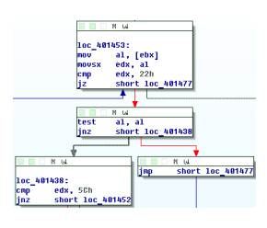
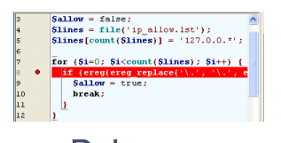



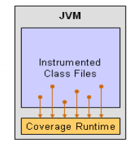


Attacker's Toolkit
Tools in REE
Tools in TEE
Root tool (e.g., KingRoot)
Decompiler（e.g., JEB）
Disassembler (e.g., IDA)
Debugger Tool (e.g., GDB)
Introspection (e.g., Androguard)
Instrumenting （e.g., ADBI）
TEE SDK
Side Channel, Snooping

Slide 73
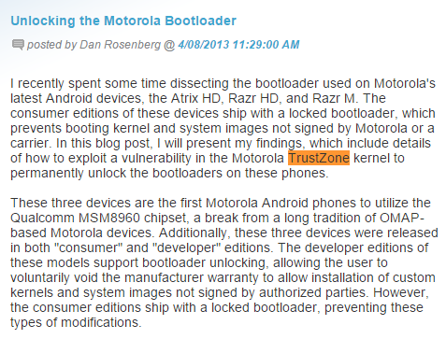
Attack on Secure Boot
2013, Many Moto and Samsung Phone
  Exploit TrustZone Kernel
Unlock bootloader
  Can load any OS kernel
Source: http://blog.azimuthsecurity.com/2013/04/unlocking-motorola-bootloader.html

Slide 74
Attacks on TEE
QualComm QSEE Bug: CVE-2014-4322
  drivers/misc/qseecom.c
  No sanity check on offset and length
  May lead to privilege escalation or DoS
Huawei RTOSck Bug: CVE-2015-4422
  Lead to any code execution
  No ASLR or NX enabled

Slide 75
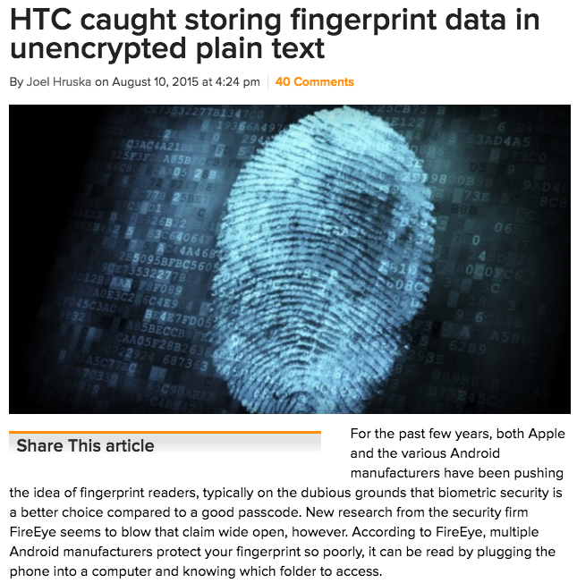
Attacks on TA

Slide 76
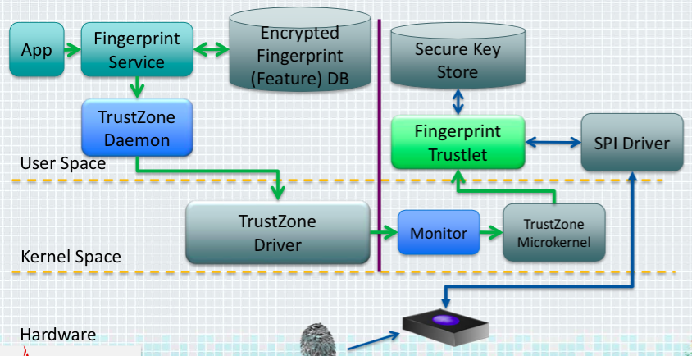
Attacks on Peripherals
Blackhat'15: Samsung S5 has bug on fingerprint reader

Slide 77
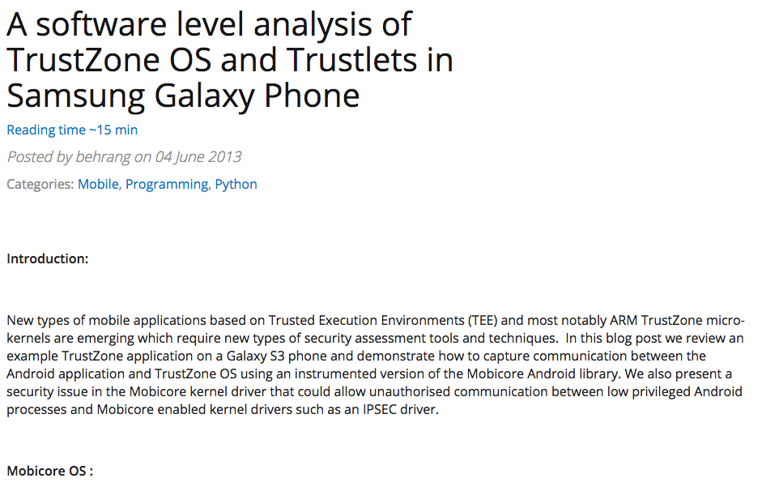
Attack on Interaction between REE & TEE
TEE Driver Privilege Escalation: CVE-2015-4421
  Incorrect boundary check
Samsung TEE Kernel MITM

Slide 78
TEE Virtualization

Slide 79
Why Multiple Isolated TEEs are Needed?
Reason-1: More and more CVEs of TEE OS and TAs are disclosed
Reason-2: A compromised TEE may breach the entire system (with highest privilege)
Reason-3: App vendors (e.g., mobile payment) may compensate users for the faults of TEE OS, thus they prefer to run on TEEs they trust (e.g., their own)
Affected Component | Description | CVE
TEE OS | TEE data leakage or code execution | ~79%
TA in TEE | Compromised TA affects other TAs | ~13%
REE | TEE vulnerability leads to privilege escalation | ~8%
We have a comprehensive analysis on 48 TEE-related CVEs (more details in paper)
Notes:
In this paper, we argue that it is needed to have multiple isolated TEE, for three reasons.
First, there are more and more CVEs... we found 48 CVEs on different TEEs.
Second, xxx
Last but not least, we find that app vendors have incentive to have their own TEEs.
We have done a comprehensive analysis ... and find three types of CVEs: affect TEE OS, in TA, or REE.
More details are in the paper.

Slide 80

CVE Example: The Boomerang Attack
Boomerang attack
  A time service running in the secure world
    Writing current time to a memory address (as parameter)
  The bug: no check on the address → arbitrary memory writes to REE
    Recall that TEE has higher privilege than REE
    Similar bugs exist in QualComm, Trustonic, SierrawareTEE, Huawei, OP-TEE
Deprivileged TEEs are needed
[NDSS'17] BOOMERANG: Exploiting the Semantic Gap in Trusted Execution Environments
Notes:
Let's show one example: the boomerang attack on 2016 and published on 2017.
In this example, a time service running in the secure world, which will write current time to a memory address which is passed to the service routine as a parameter. The bug, as many bugs, is that the routine forgets to check the range of the address.
Recall that the TEE has highest privilege, it can write to any memory address of the system with the value of current time, which can also be controlled.
Similar bugs are found in various TEE OS.
Thus, we argue that TEE should be deprivileged, otherwise a breached TEE may do arbitrary writing.

Slide 81
Goals of vTEE
Virtualizing TEE to support multiple, isolated TEE instances
  Challenge: TEE-visor and vTEE instances run with the same privilege
Minimizing TCB for TEEv
  Challenge: the hypervisor has to be as small as possible
Non-intrusive to existing TEEs
  Challenge: no intrusive modification to existing TEE software stack
Compatible with existing secure device driver model
  Challenge: not practical for all TEE instances to have all device drivers
Notes:
Our design has following four goals.

Slide 82
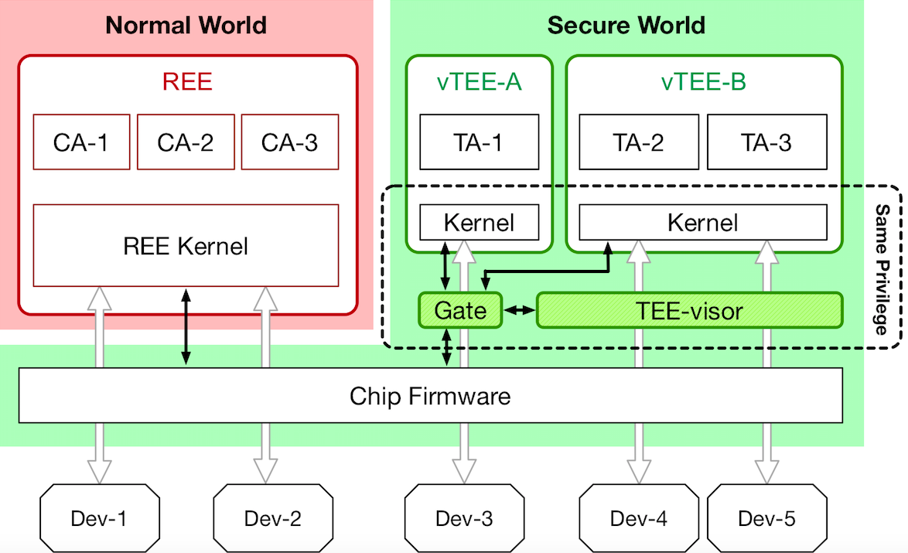
TEEv: Enabling Multiple Virtualized TEEs
Notes:
Here is the architecture of our design. There are four components of the system.

Slide 83
TEEv: Enabling Multiple Restricted TEEs
TEE-visor
  Supporting multiple vTEEs
  Isolating itself from vTEE kernels
Gate
  For secure context switching between vTEE kernel and TEE-visor
Secure interaction
  Communication channels between different contexts
I/O virtualization
  Support various secure devices
Notes:
Specifically, our design has four components.

Slide 84
TEE-visor: Isolating from vTEE Kernels
Challenge
  TEE-visor and vTEEs run in the same privilege
Solution: MMU virtualization
  TEE-visor exclusively controls and checks:
    all the memory mappings in vTEEs, and
    no MMU operation instruction in vTEEs
  TEE-visor enforces:
    integrity and confidentiality of itself, and
    vTEE kernel's life-time code integrity
Notes:
For tee-visor, the major challenge is to protect itself from vTEE's kernel.
We leverage MMU virtualization to ensure that TEE-visor is the only component that can control the MMU.
It will check all the memory mappings to ensure certain policies, and enforce the integrity and confidentiality of itself, as well as the code integrity of vTEE's kernel.

Slide 85
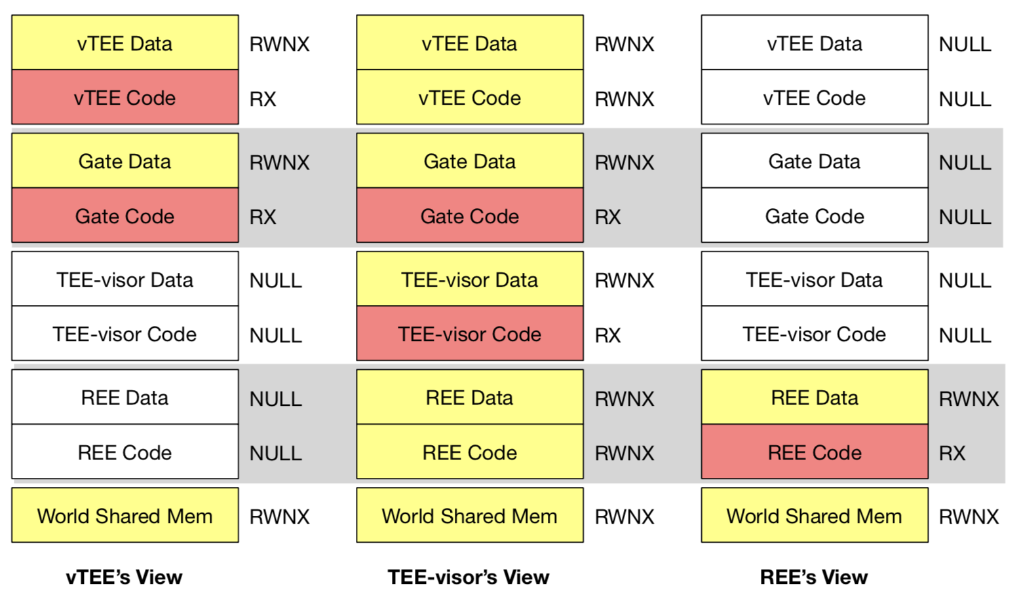
TEE-visor: Controlling Memory Mappings
TEE-visor controls MMU
  Tracks all memory permission
  Enforces each execution context to its own memory view
Different memory views
  TEE-visor has a global view of memory
  vTEE and REE could only access their own section and the world-share memory
Notes:
Since TEE-visor controls the mapping the memory,
It can ensure that vTEE instances cannot access the memory of either TEE-visor or the REE.
The code and data of gate region are mapped to vTEE.
There is a world shared memory region that is mapped to vTEE, REE, and TEE-visor, which is used for communication.

Slide 86
Gate: Secure Context Switching
The only entry point for context switch
  The gate is executed in monitor mode
  Invoked through SMC instruction with interrupt disabled
Integrity of gate code and data
  Avoid gate data being corrupted
Atomic to avoid partial execution or shortcuts
  Defending jump-to-the-middle attacks
  Defending interrupt-execution attacks
Notes:
The gate is the only entry point for context switch.
It is xxx.
The most important feature to enforce is atomicity.
Specifically, there are two kinds of attack need to be considered.
We will describe the first one in this presentation.

Slide 87
Gate: Defending Jump-to-the-middle Attack
Prevent direct jump to line 18
  May control the page table
  Solution: a check after page table switching
Protect the check code
  May switch the code page to bypass the check
  Solution: use TLB lockdown to lock the code page's address
...
load teevisor's page table addr to r1
write r1 to TTBR0 ← (only one here)
...
read current page table addr to r1
check r1 == teevisor's page table addr
...
18
The code snippet of Gate
Notes:
Here is a piece of code snippet of gate.
During a world switch, vTEE needs to switch to teevisor first.
The gate first loads the physical address of teevisor's to r1 register, and write r1 to TTBR0 (which is similar to the CR3 of x86 platform).
This is the only place to update page table.
However, since this code is also mapped to vTEE's address space, a malicious code in vTEE can load r1 with some other page table and jump to the Line 18 directly to change to a malicious page table.
In order to defend this attack, the gate will reload the page table after line 18 and check whether it equals the teevisor's page table.
However, since line 18 will switch the page table, the new page table may remap the gate's code page to bypass the second check.
Our solution is to leverage TLB lockdown feature of Arm so that the new page table after line 18 will have no effect if it is different from the TLB.
Therefore, the check will not be bypassed.

Slide 88
Gate: Defending Interrupt-execution Attacks
Attack by interrupt
  Jump to Line 18 with interrupt enabled
  Trigger an interrupt before check
  and change r1 to a legal value
Solution
  TEE-visor controls interrupt handlers
  Alert if an interrupt happens when executing gate's code
...
load teevisor's page table addr to r1
write r1 to TTBR0 ← (only one here)
...
read current page table addr to r1
check r1 == teevisor's page table addr
...
18
int
The code snippet of Gate
Notes:
Second, if an attacker jump to line 18 with interrupt enabled, it is possible that an interrupt happens just after Line 18.
Then the attacker gets an chance to change r1 to the value of teevisor's legal page table.
Our solution is to control all the interrupt handler by TEE-visor, which will intercept all the handlers to check whether the interrupt happens during the execution of gate's code.
If so, an alert will be thrown.

Slide 89
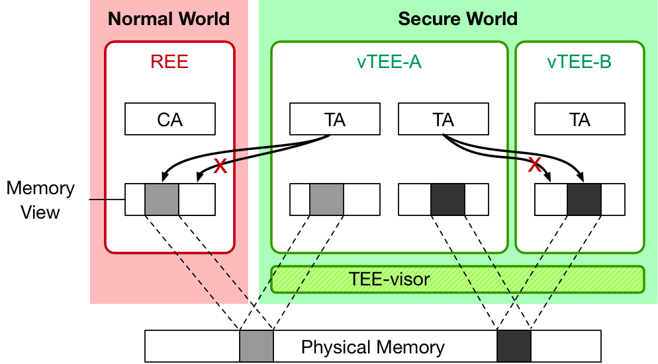
Interaction: between vTEEs & vTEE/REE
Secure communication channel by TEE-visor
  TEE-visor manages the shared memory pages between vTEEs and vTEE/REE
  Memory pages in one context need to be explicitly registered to be used by other contexts
Defend Boomerang attack
Notes:
The interactive between vTEEs and vTEE and REE is done by explicit memory mapping.
The Tee-visor will manage all the mapping.
So that even if a vTEE is compromised, it cannot access other vTEE's or the REE's pages which are not mapped to it.
Thus, the boomerang attack can be mitigated.

Slide 90
I/O Virtualization: Three Modes
Observations
  Different TAs usually do not share devices
  Device drivers used in TEE are quite diverse
Notes:
For I/O virtualization, we have two observations
first, xxx
second, yyy
In order to support different scenarios, we leverages three modes of I/O virtualization, and introduce a system-vTEE to minimize the porting effort of device drivers.
The first mode is delegation mode.
In this mode, the system-vTEE controls the device and offer services through some trusted applications.
For example, fingerprint scanner is the mostly common device on the phones.
The phone vender will have the driver, but a third party TEE is unlikely to have one.
Thus, it is natural to invoke the service provided by the system-vTEE to do the authtication.

Slide 91
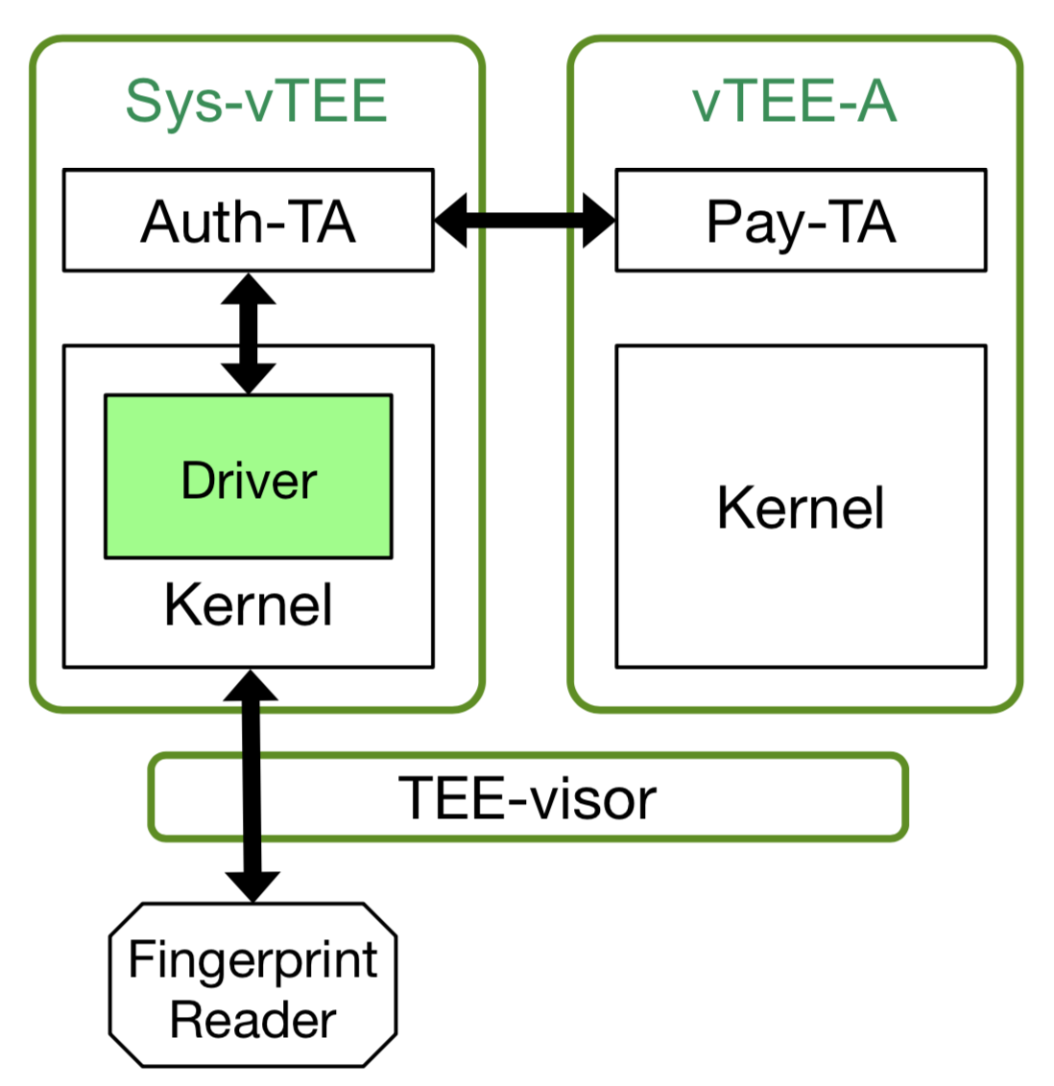
I/O Virtualization: Three Modes
Observations
  Different TAs usually do not share devices
  Device drivers used in TEE are quite diverse
Mode-1: I/O delegation
  Introduce system-vTEE (by phone venders)
  E.g., the Auth-TA acts as a proxy
  Other vTEE instances do not need to have drivers of various devices (e.g., fingerprint scanner)
Delegation Mode
Notes:
For I/O virtualization, we have two observations
first, xxx
second, yyy
In order to support different scenarios, we leverages three modes of I/O virtualization, and introduce a system-vTEE to minimize the porting effort of device drivers.
The first mode is delegation mode.
In this mode, the system-vTEE controls the device and offer services through some trusted applications.
For example, fingerprint scanner is the mostly common device on the phones.
The phone vender will have the driver, but a third party TEE is unlikely to have one.
Thus, it is natural to invoke the service provided by the system-vTEE to do the authtication.

Slide 92
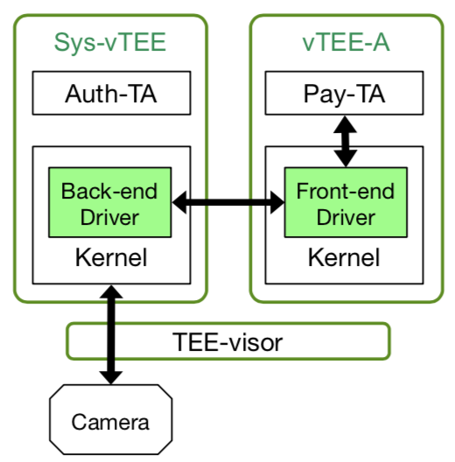
I/O Virtualization: Three Modes
Observations
  Different TAs usually do not share devices
  Device drivers used in TEE are quite diverse
Mode-2: Frontend/backend
  The system-vTEE has a backend driver
  Each vTEE instance has a frontend driver
  Less dependency on the system-vTEE
Frontend/backend Mode
Notes:
The second mode is frontend and backend driver mode.
In this mode, the system-vTEE just delivers data of the device to the vTEE.
It does not have higher semantic of the data.
In this mode, the vTEE has less dependency on the system-vTEE.
It is suitable for peripherals like camera.

Slide 93
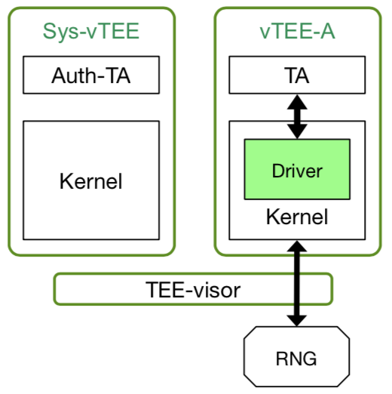
I/O Virtualization: Three Modes
Observations
  Different TAs usually do not share devices
  Device drivers used in TEE are quite diverse
Mode-3: Passthrough
  A vTEE instance controls a device directly
  No dependence on the system-vTEE
  Require the vTEE instance has its own driver
Passthrough Mode
Tradeoff between security and availability
Notes:
The third mode is passthrough mode.
In this mode, the device is controlled exclusively by the vTEE.
It has no dependence on the system-vTEE, and is suitable for simple devices like RNG, since it requires the vTEE instance has the driver.
Here, there is a tradeoff between xxx.
The less dependency on system-vTEE, the more secure the system will be.

Slide 94
Implementation: TEEv & TEE OS Porting
Prototype platforms
  Hardware: Samsung Exynos development board & MediaTek mobile phone
  Software: Commercial TEE (T6) as system-vTEE & open-source TEE (OP-TEE)
TCB size
  About 4200 sLOC for TEE-visor
  vTEE needs to partially trust system-vTEE (optional)
Porting efforts of TEE OS
  Less than 300 sLOC modification in both TEE kernels
  3 days porting efforts for one TEE kernel developer for each OS
Notes:
We have implemented TEEv on two platforms, one is xxx, the other is xxx.
The size of TEE-visor is around 4200 lines of code.
The TCB also includes system-vTEE, if it is used.
The porting effort is small.
It takes one developer 3 days to port each OS and change around 300 lines of code.

Slide 95
Evaluation: TEE Service Invocation Latency
System | TA Location | Latency (ms) | Overhead
Original TEE | Memory | 116.0 | 0
Original TEE | External storage | 586.4 | 0
TEEv | Memory | 232.5 | 100.4%
TEEv | External storage | 745.3 | 27.1%
Notes:
We evaluate the latency of TEE's service invocation.
Using TEEv, if the TA has been loaded into memory, TEEv will add around 100 ms to the latency.
If the TA is on disk, TEEv will add around 150 ms.

Slide 96
Evaluation: Overhead of Context Switch
Context Switch Type | Latency (ms) | Overhead
between TAs within original TEE | 6.8 | 0
between TAs within a system-vTEE | 10.6 | 55.9%
between TAs from different vTEEs | 16 | 135.3%
from vTEE to TEE-visor | 0.2 | -
Notes:
We also evaluate the context switch latency.
It takes around 10 ms to switch between TAs within the same vTEE, and 16ms between TAs on different vTEE.
The switch between vTEE and TEE-visor is around 0.2ms.

Slide 97
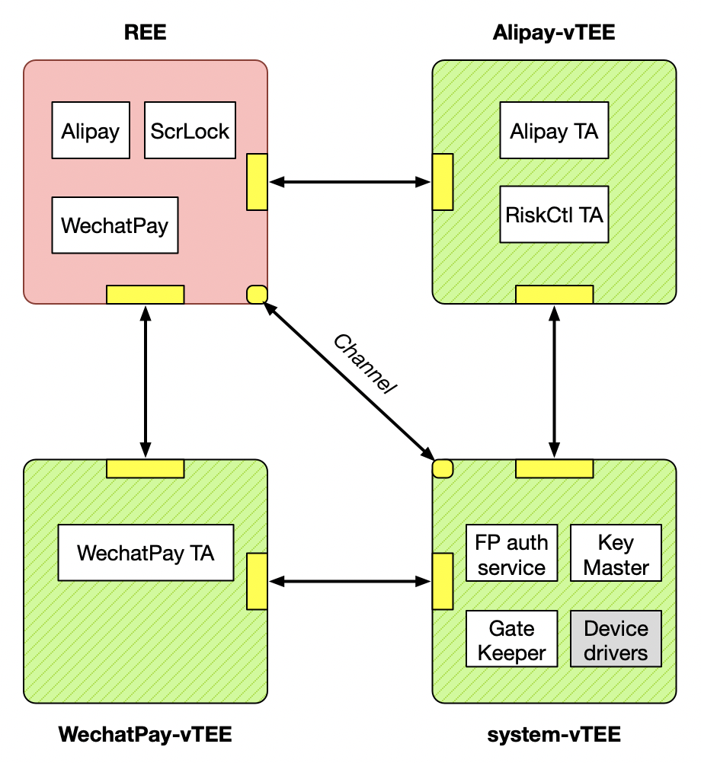
Case Study:
Unlock & secure payment
Multiple TAs in 3 vTEEs
  Fingerprint, Keymaster and GateKeeper in system-vTEE
  Alipay and Wechat Pay in separate vTEEs, respectively
Overhead of latency
  Device unlock using FP: 18.7%
  Device unlock using PIN: 6.1%
  Alipay secure payment: 13.9%
Notes:
We also did a macro benchmark, which is also a case study.
We deploy 6 TAs in 3 vTEE instances.
There is a FP auth TA in the system vTEE, one payment TA in ta-vTEE, and three TA in pay-vTEE, which are alipay, facial recogonization, risk control.
We measure the latency of device unlocking using fignerprint, using PIN code and secure payment. The overhead are all less than 19%.

